Slide 2
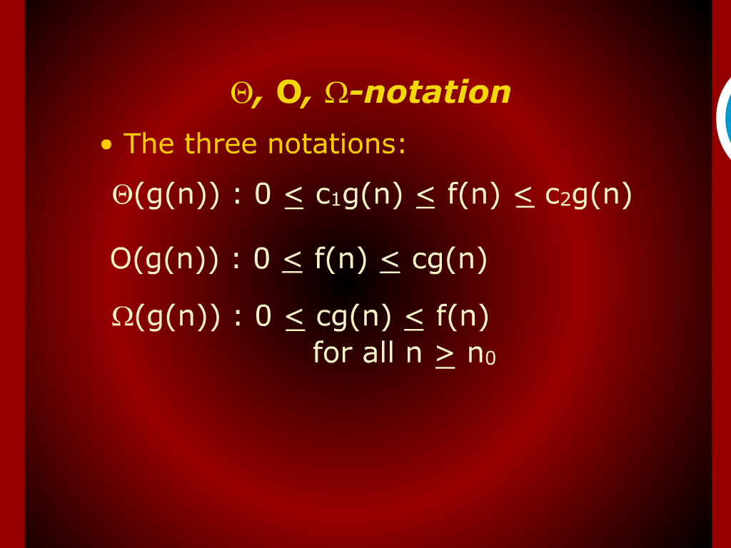
Notation

Slide 3
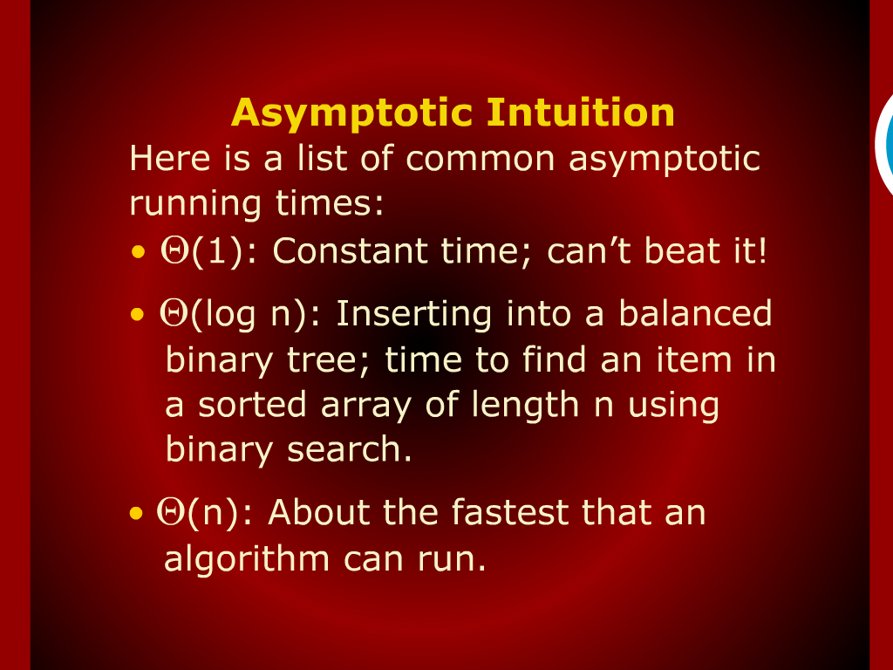
Asymptotic Intuition

Slide 4
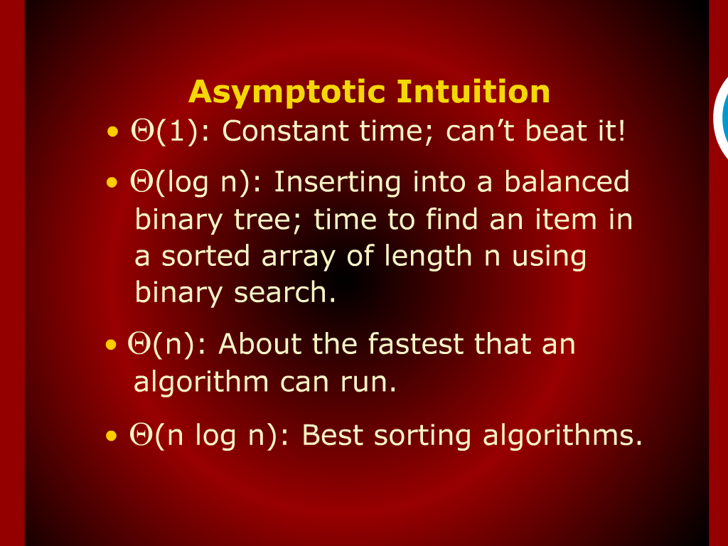
Asymptotic Intuition

Slide 5
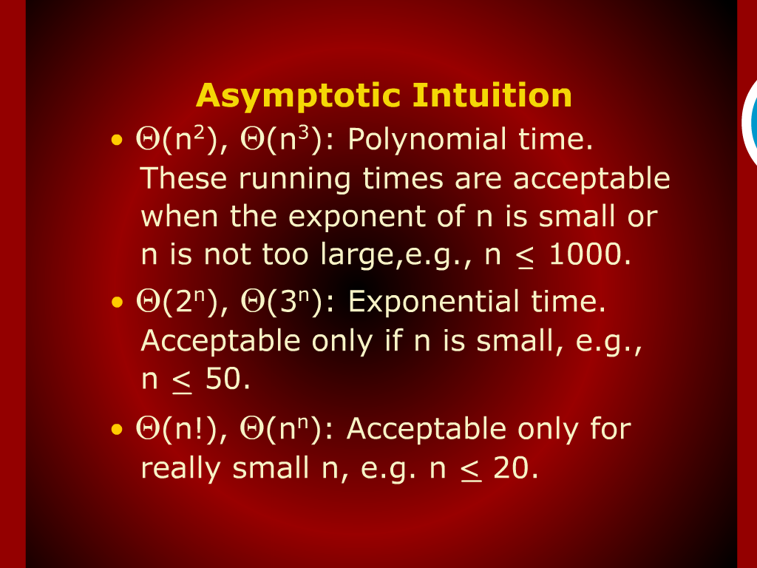
Asymptotic Intuition

Slide 6

Divide and Conquer Strategy

Slide 7
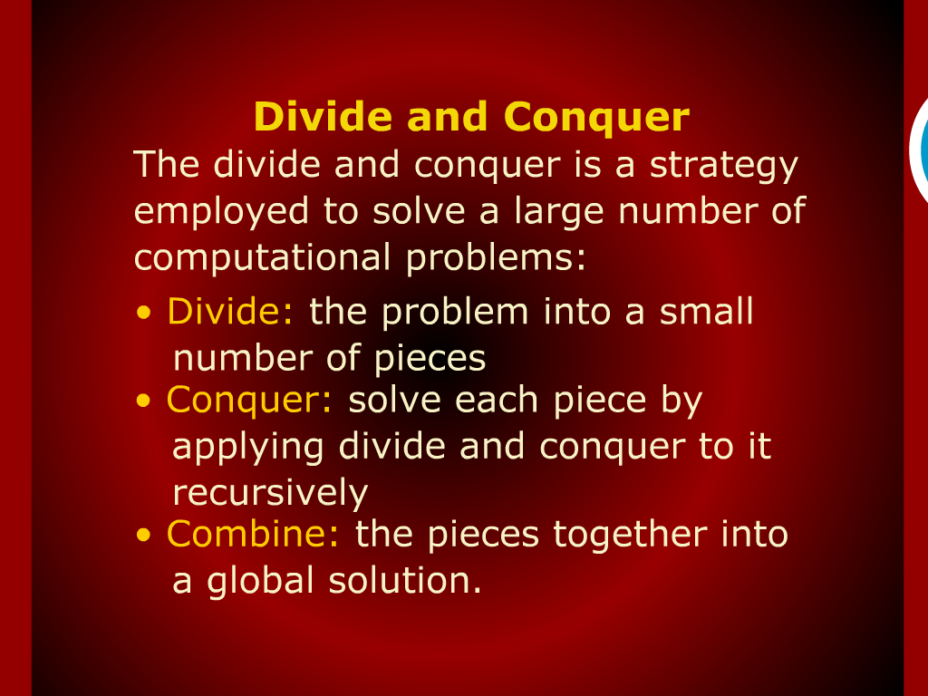
Divide and Conquer

Slide 8
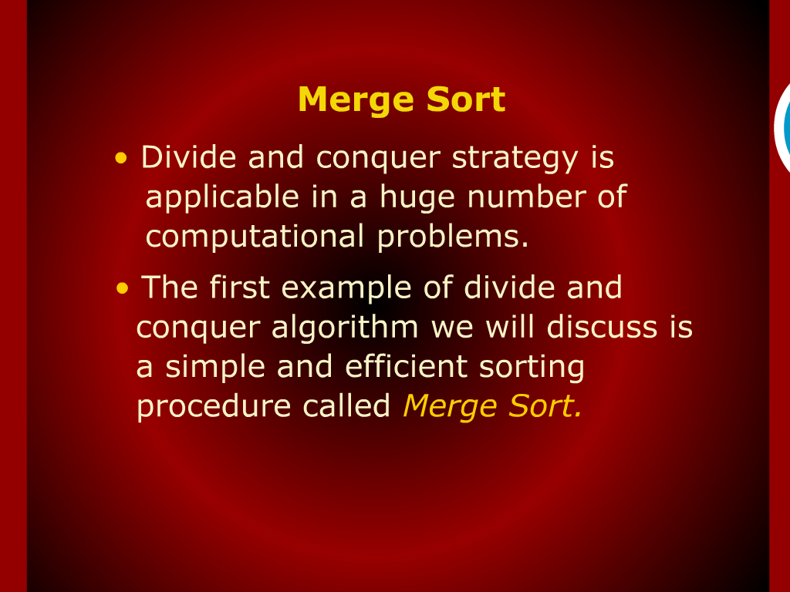
Merge Sort

Slide 9
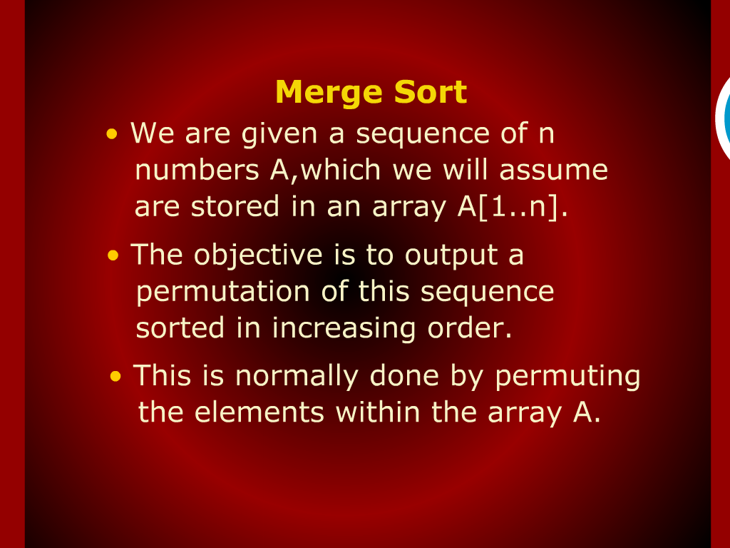
Merge Sort

Slide 10
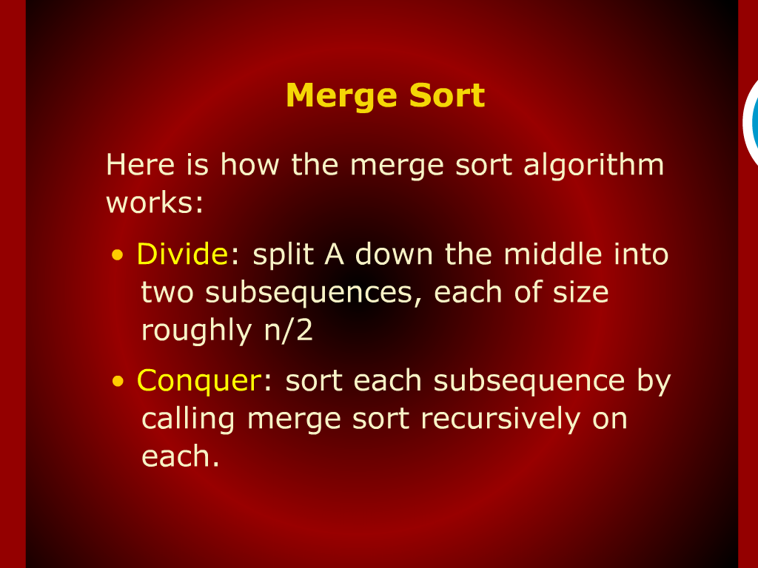
Merge Sort

Slide 11
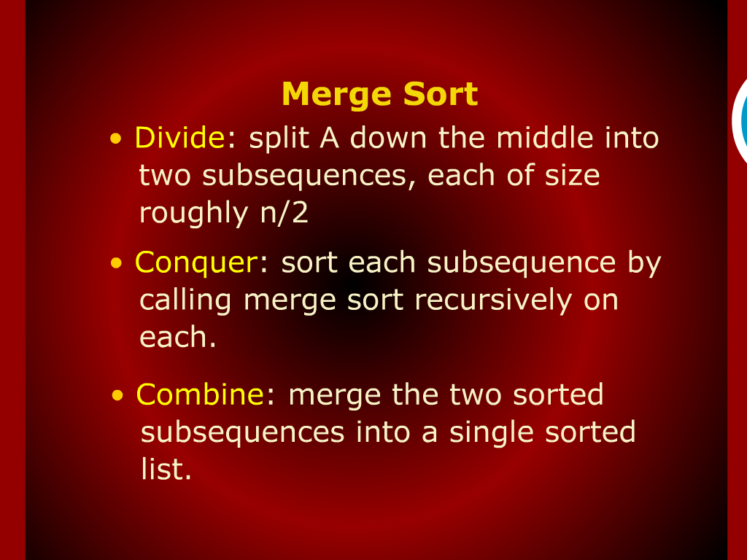
Merge Sort

Slide 12
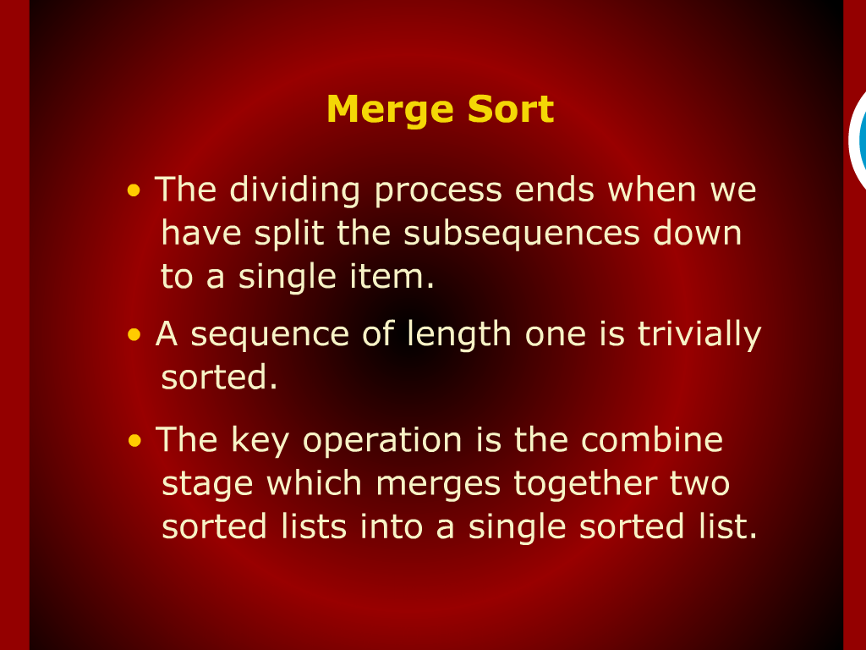
Merge Sort

Slide 13
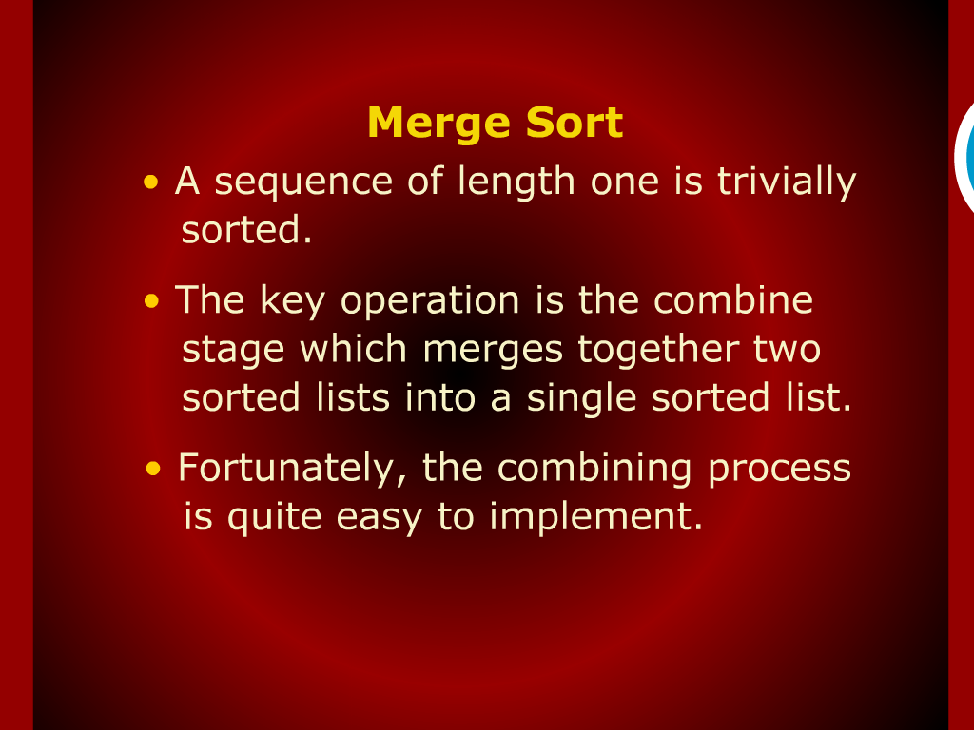
Merge Sort

Slide 14
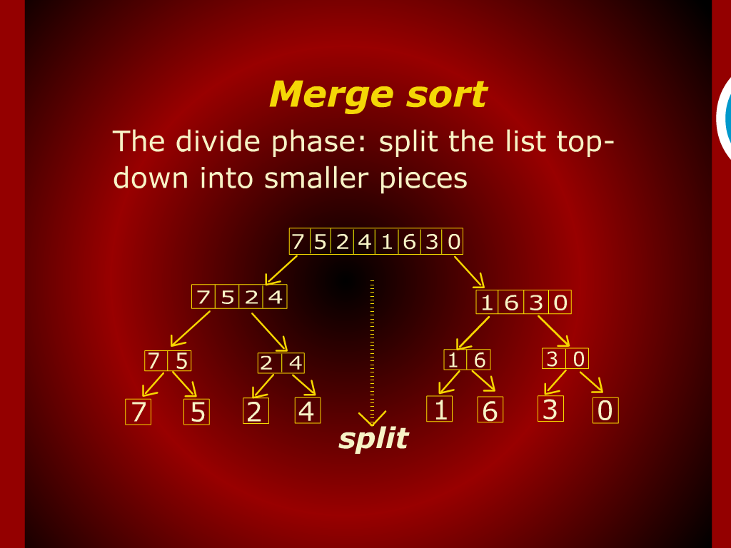
Merge Sort

Slide 15
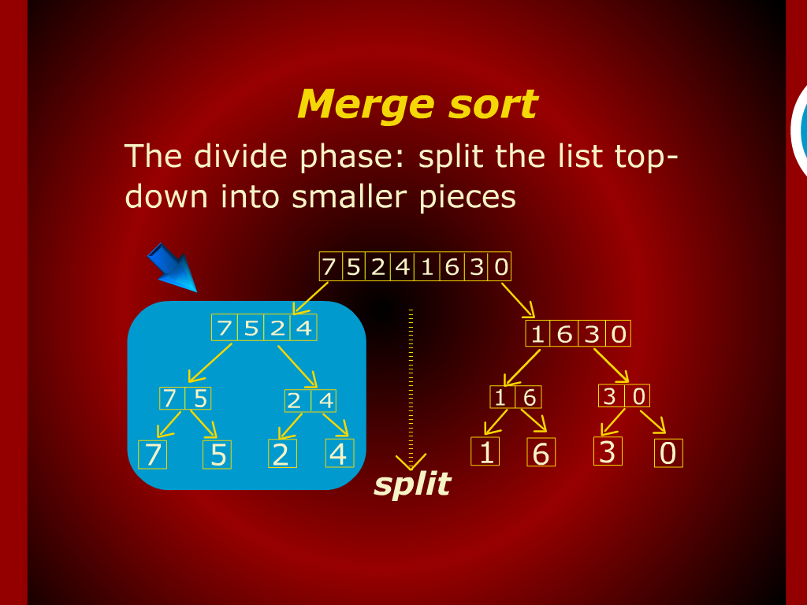
Merge Sort

Slide 16
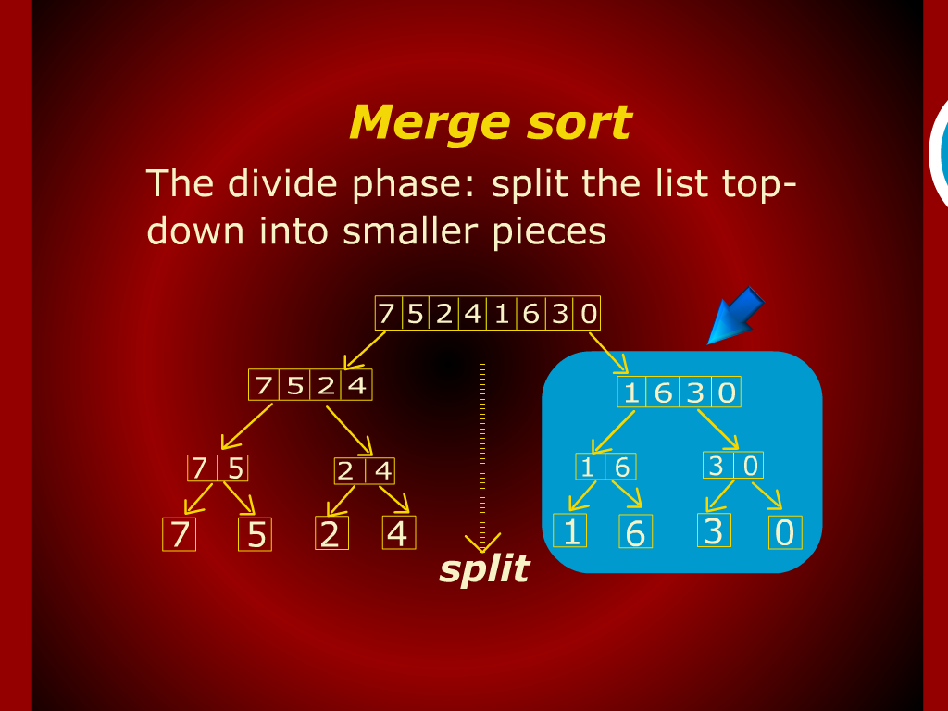
Merge Sort

Slide 17
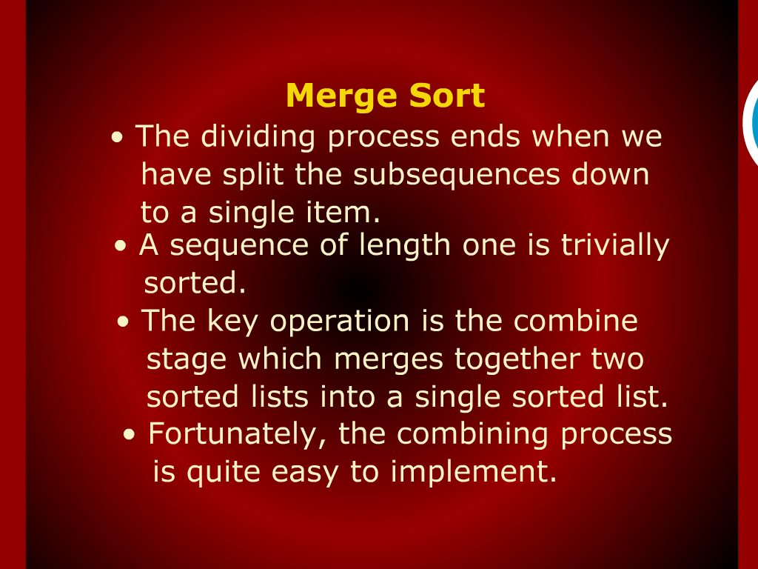
Merge Sort

Slide 18
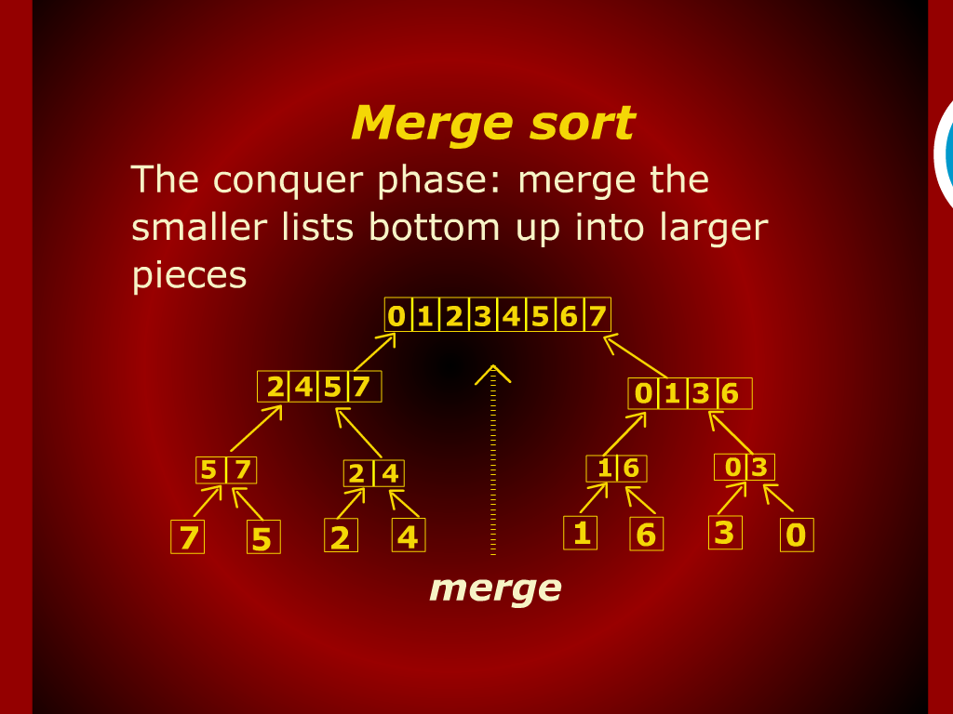
Merge Sort

Slide 19
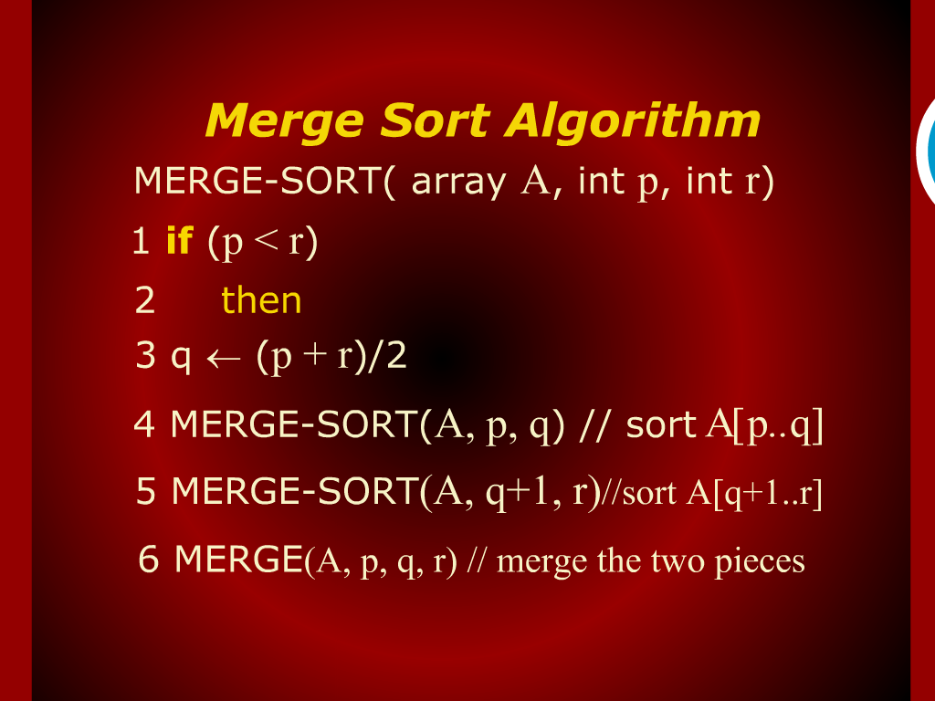
Merge Sort Algorithm

Slide 20
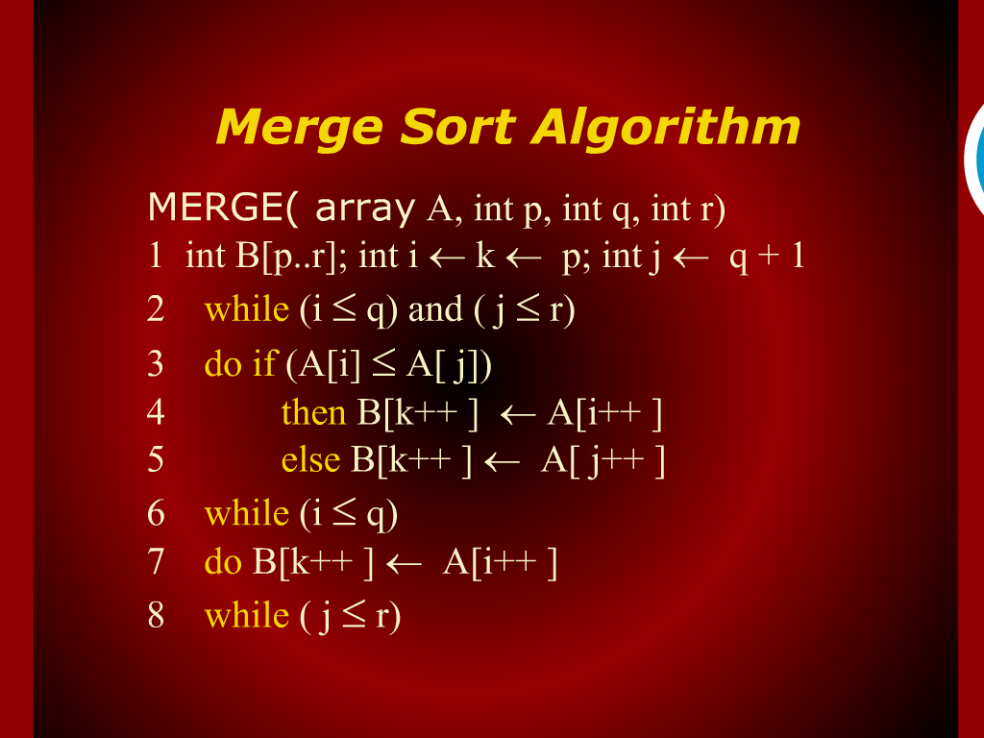
Merge Sort Algorithm

Slide 21
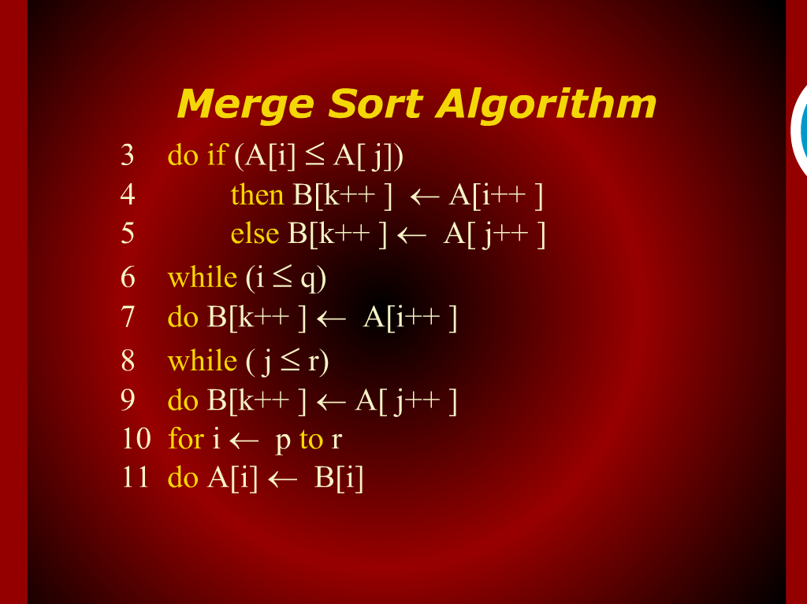
Merge Sort Algorithm

Slide 22
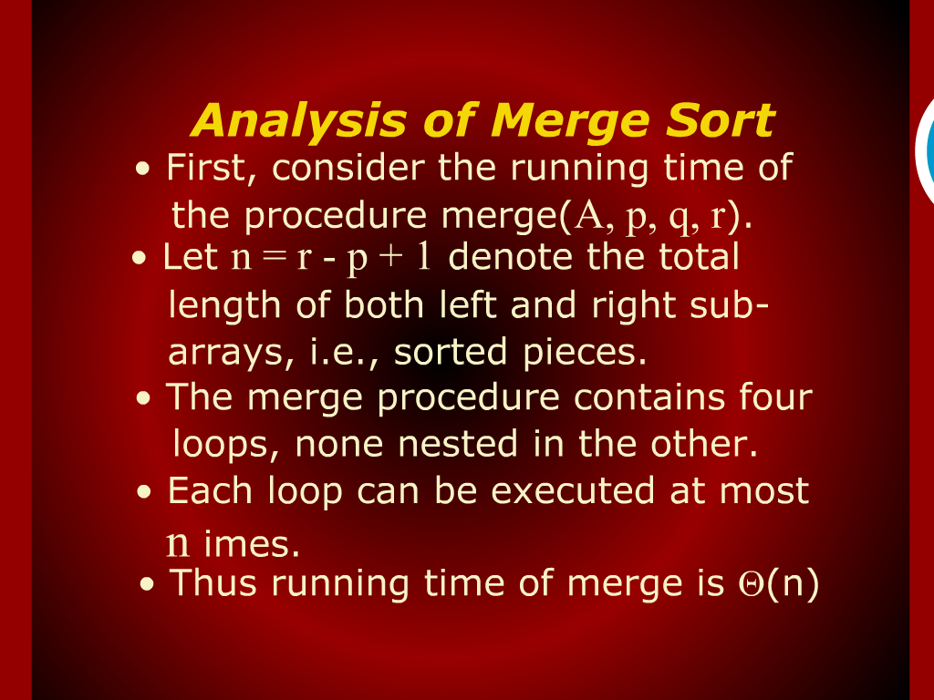
Analysis of Merge Sort

Slide 23
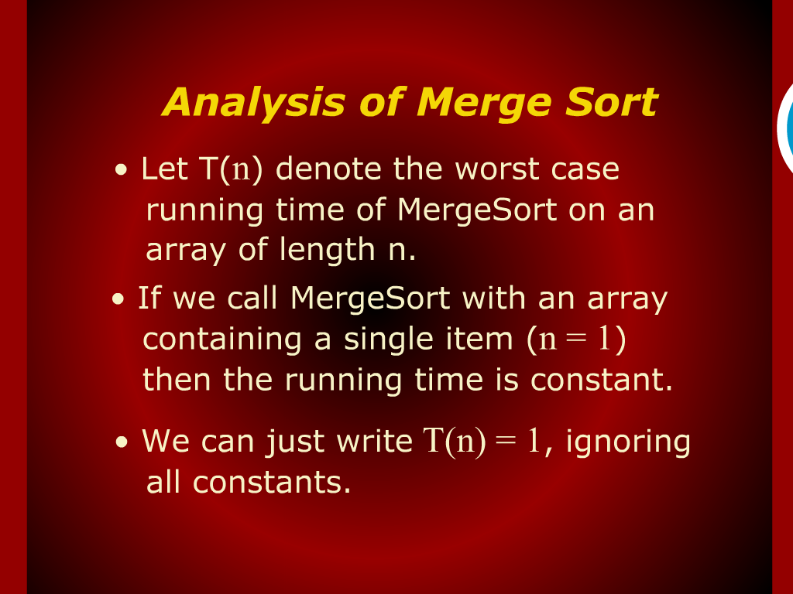
Analysis of Merge Sort

Slide 24
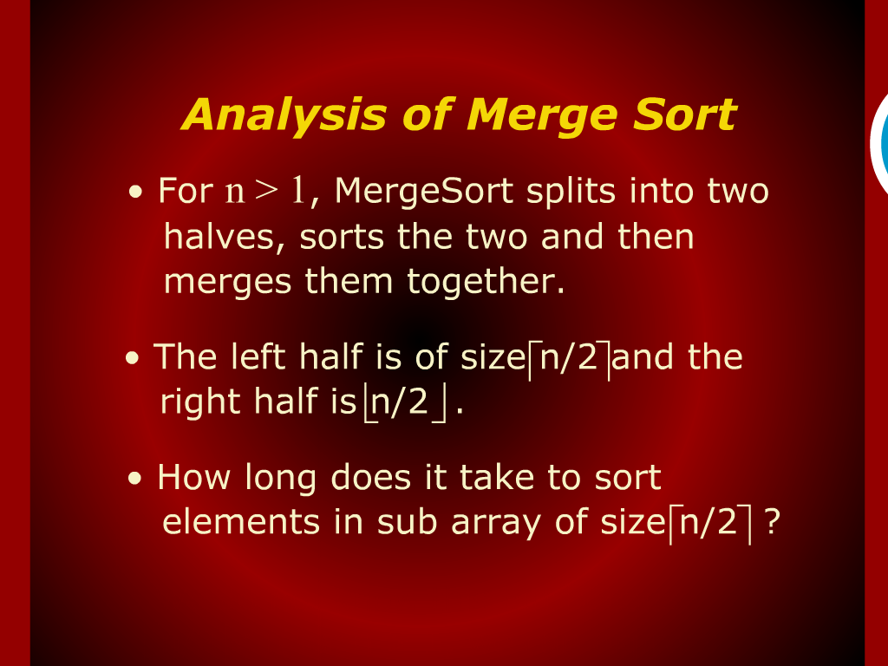
Analysis of Merge Sort

Slide 25
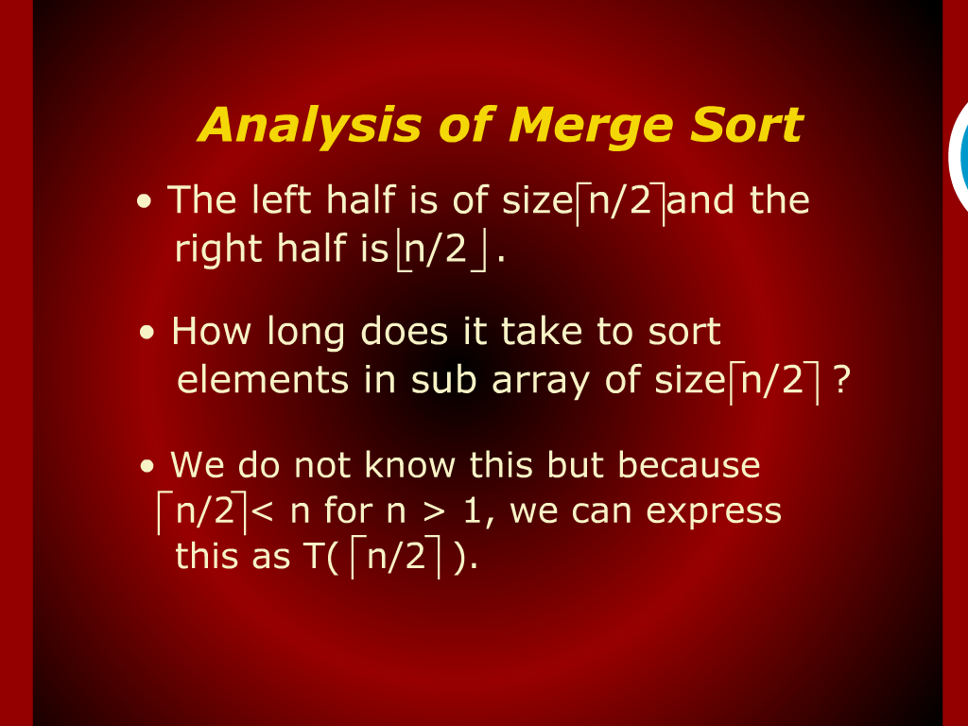
Analysis of Merge Sort

Slide 26
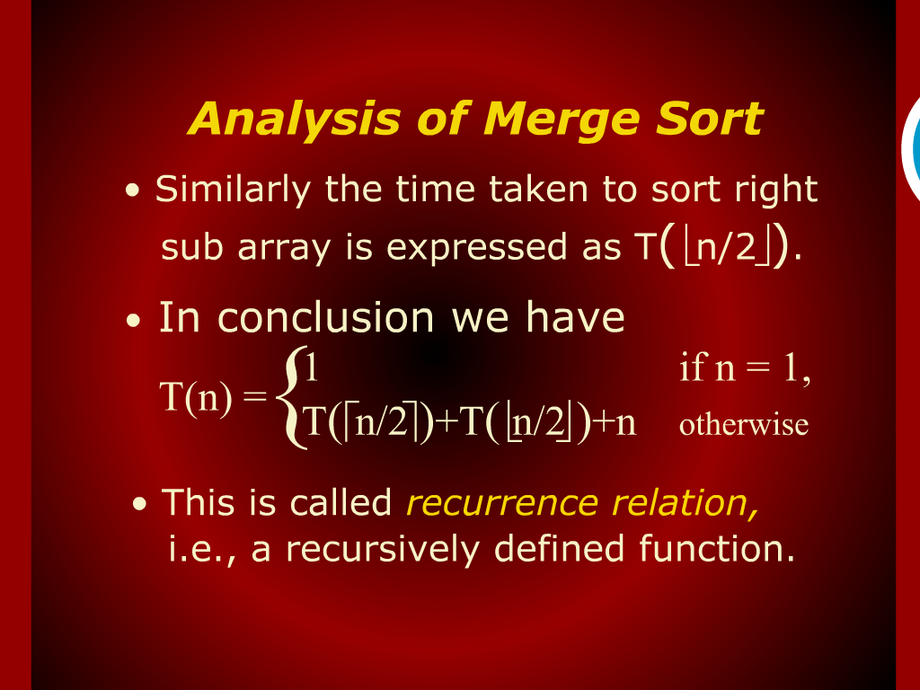
Analysis of Merge Sort

Slide 27
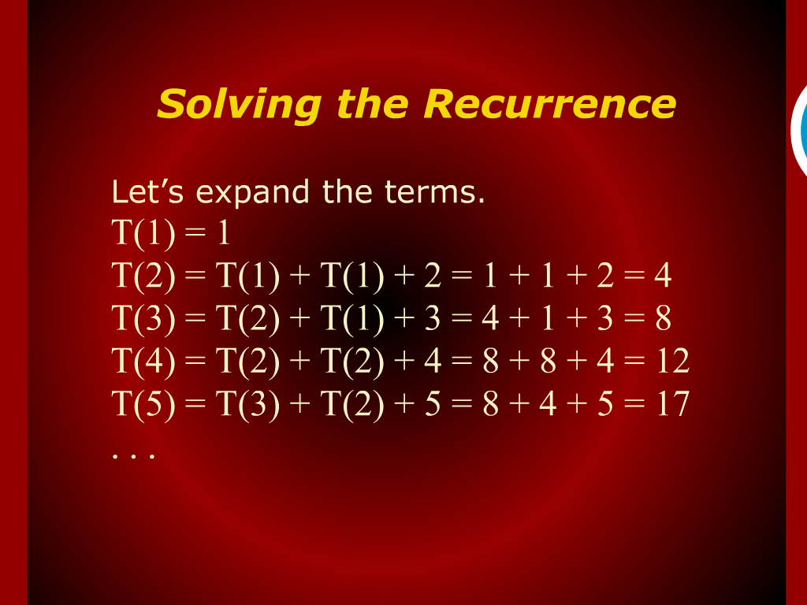
Solving the Recurrence

Slide 28
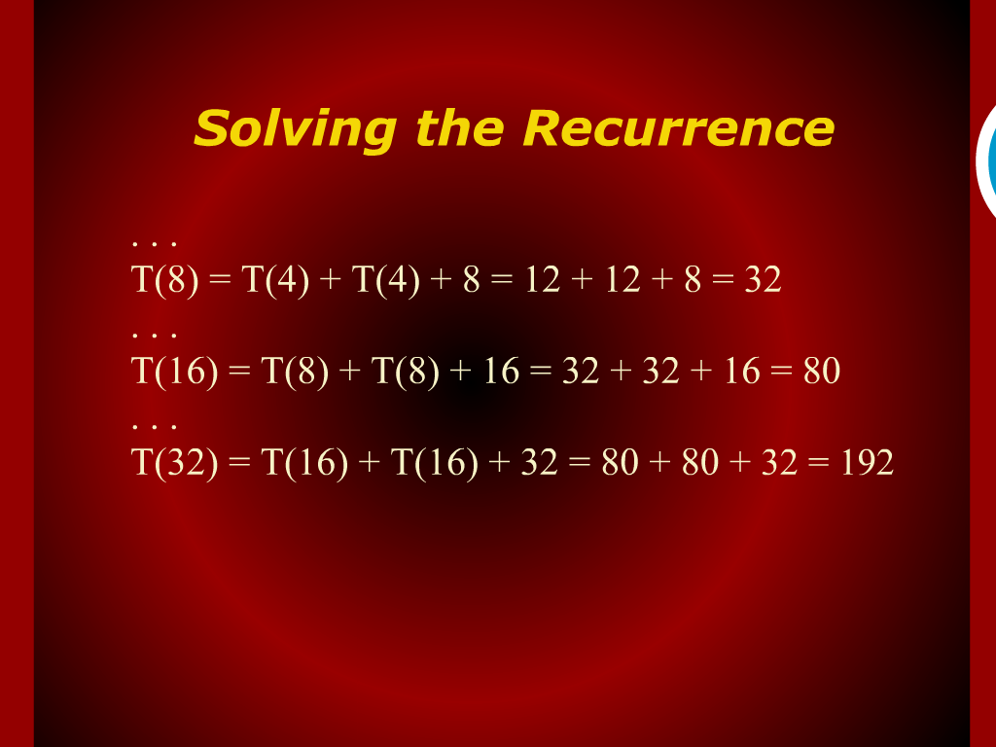
Solving the Recurrence

Slide 29
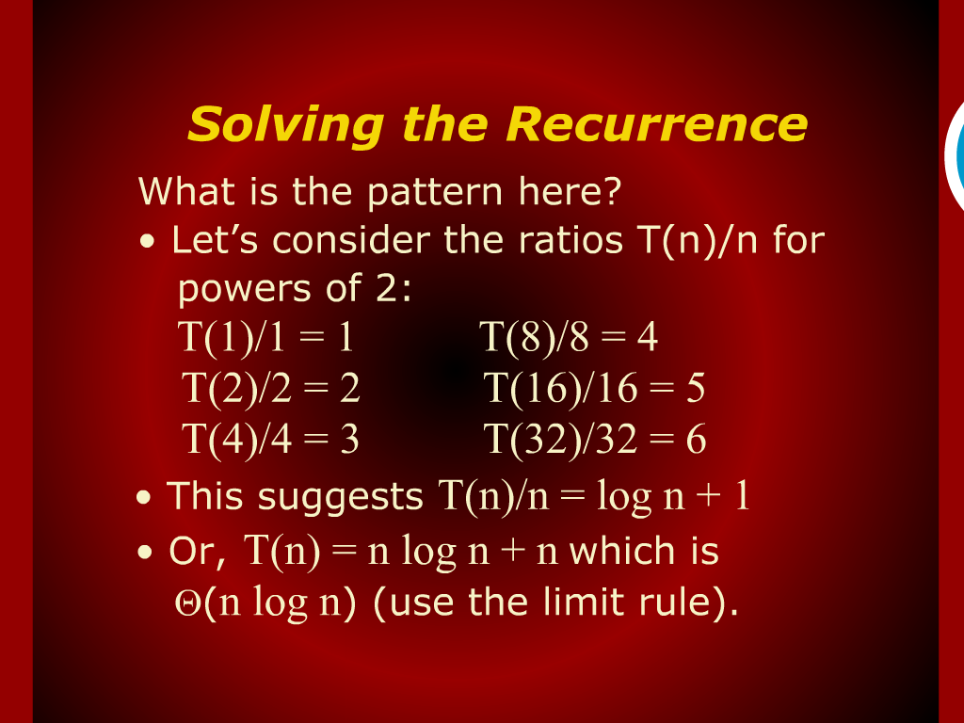
Solving the Recurrence

Slide 30
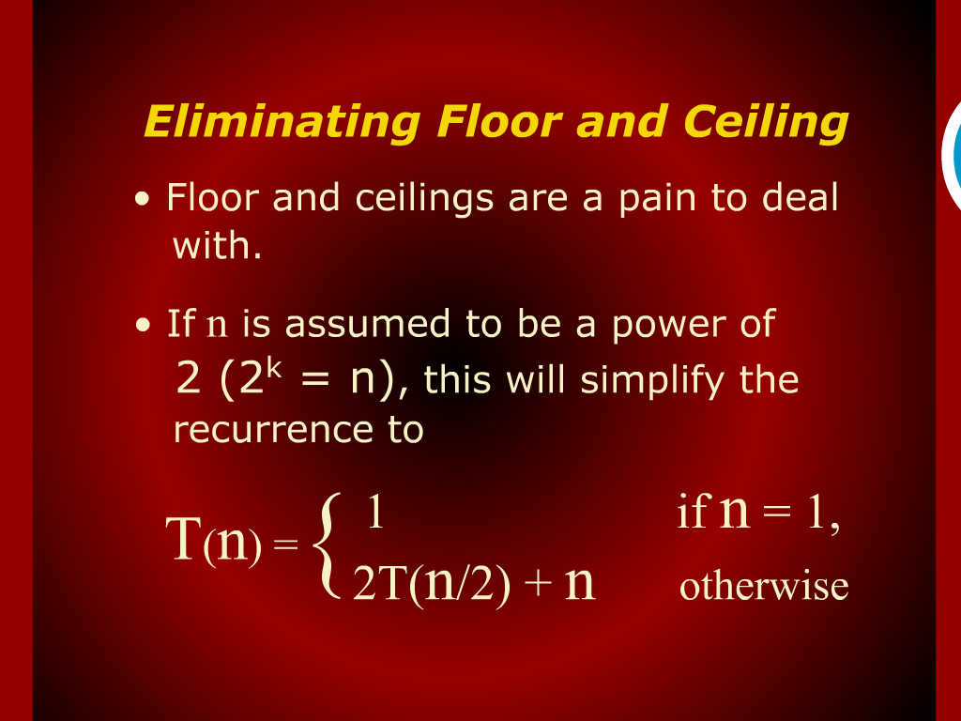
Eliminating Floor and Ceiling

Slide 31
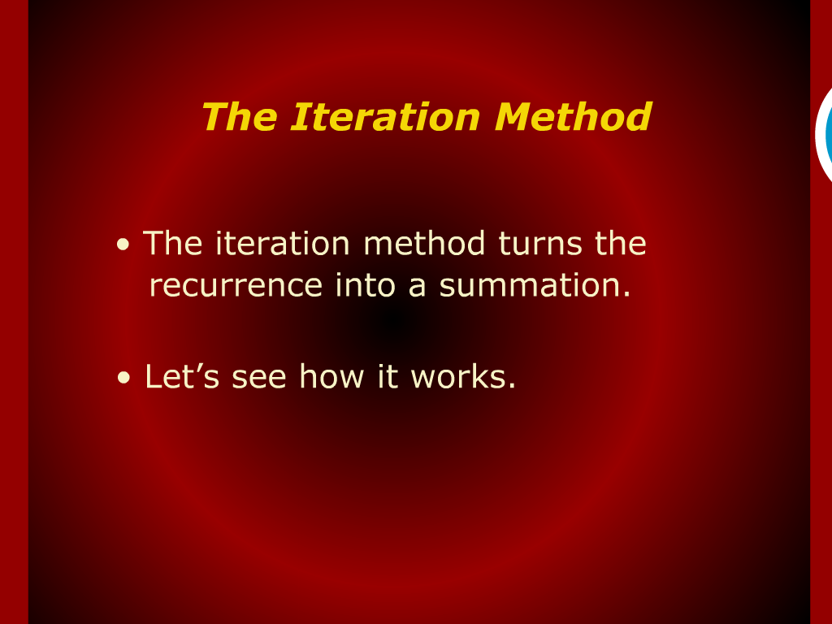
The Iteration Method

Slide 32
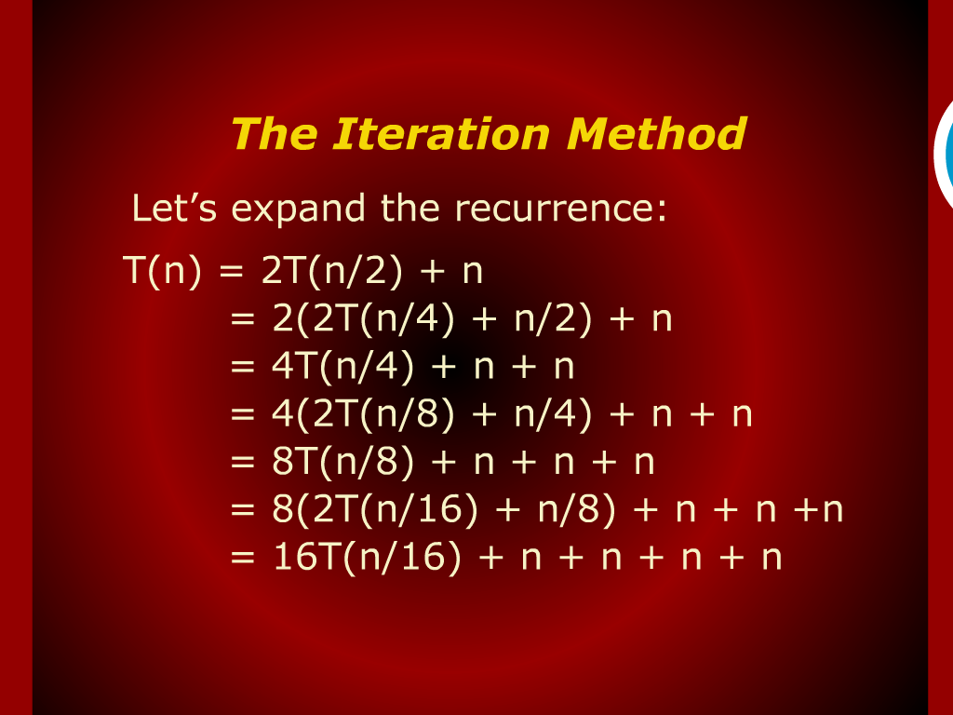
The Iteration Method

Slide 33
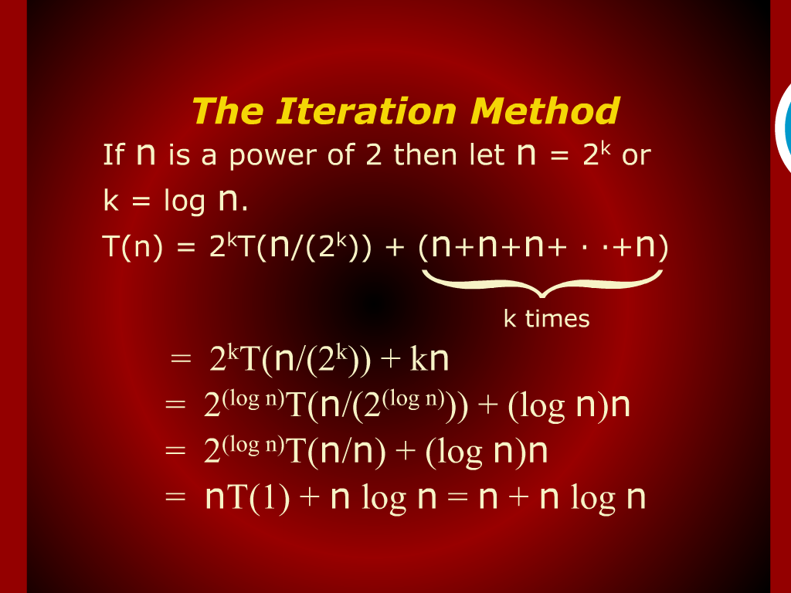
The Iteration Method

Slide 34
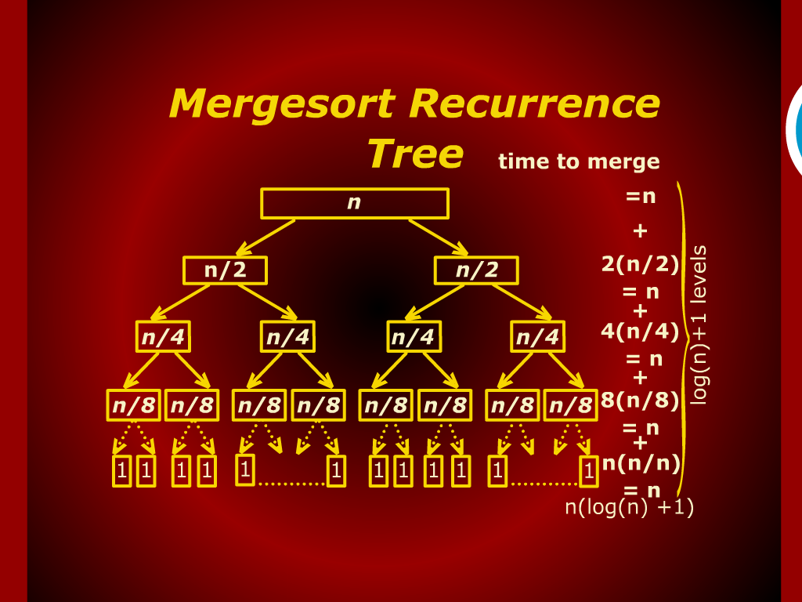
Mergesort Recurrence

Slide 35
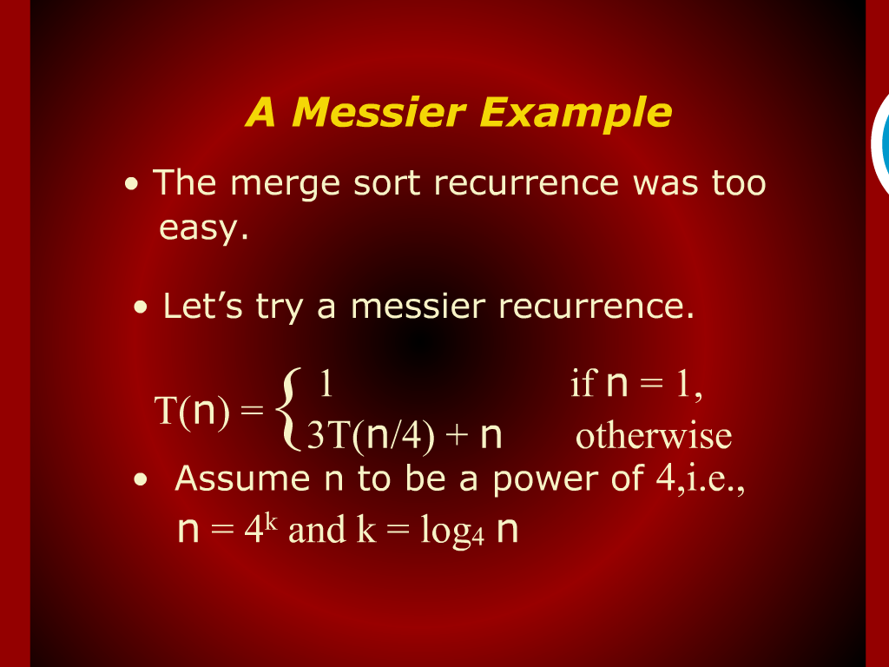
A Messier Example

Slide 36
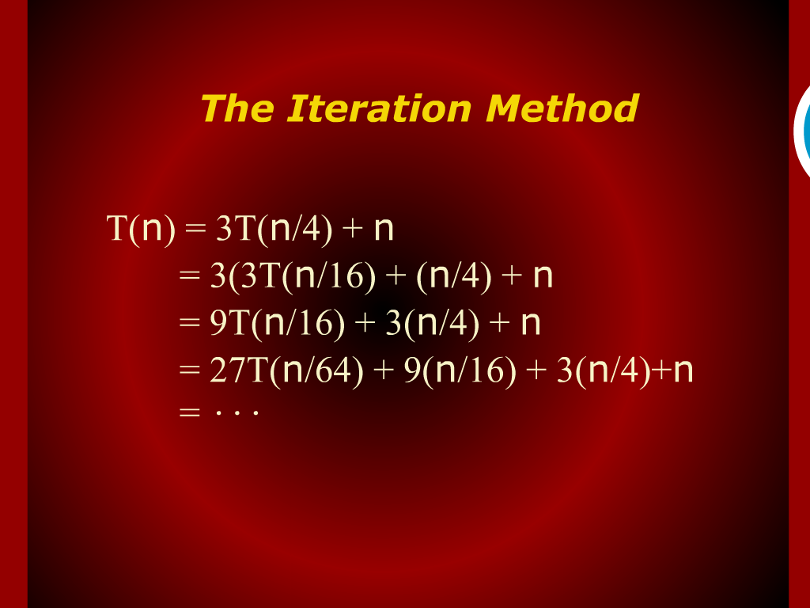
The Iteration Method

Slide 37
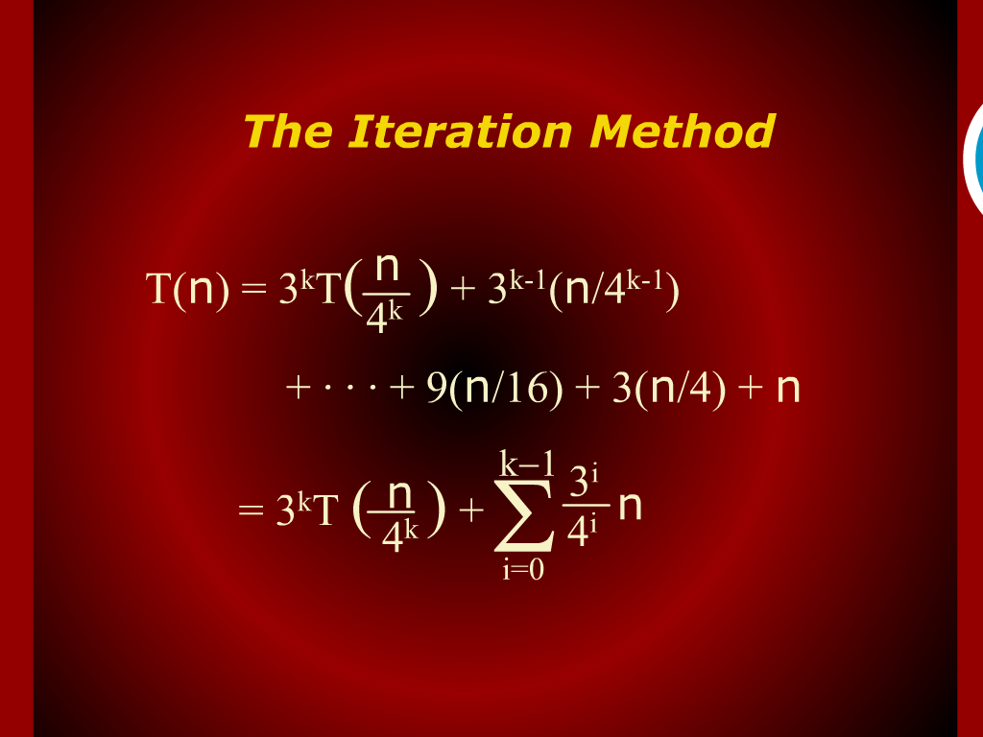
The Iteration Method

Slide 38
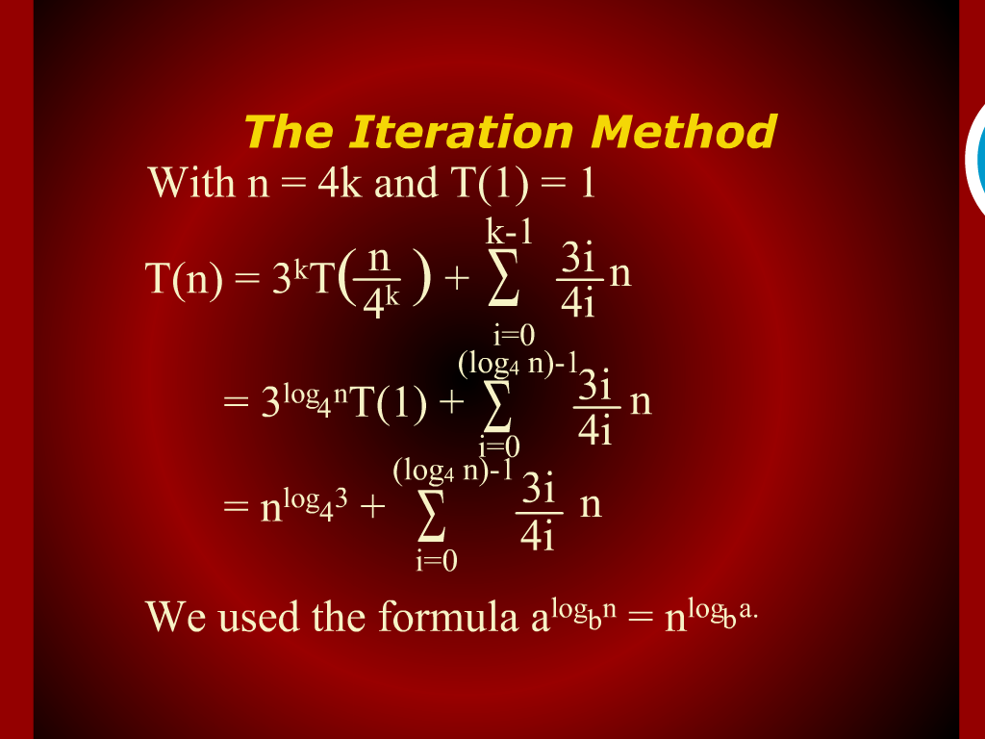
The Iteration Method

Slide 39
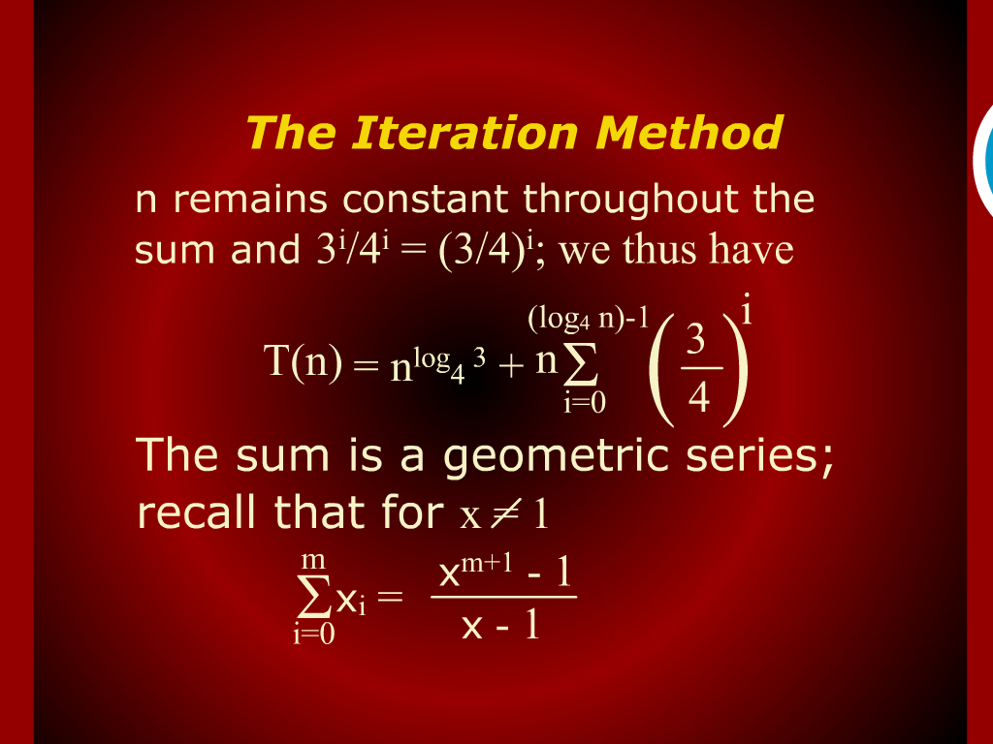
The Iteration Method

Slide 40
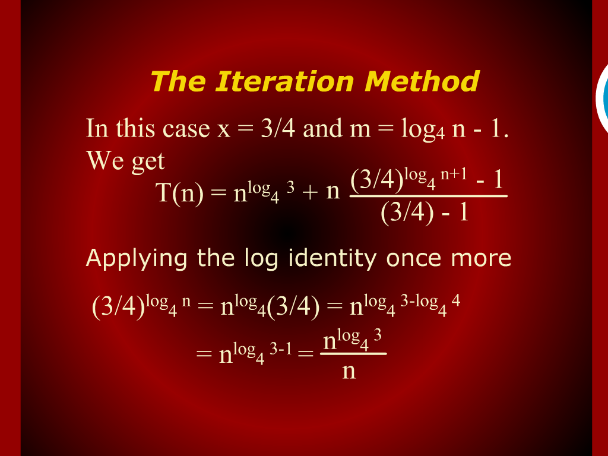
The Iteration Method

Slide 41
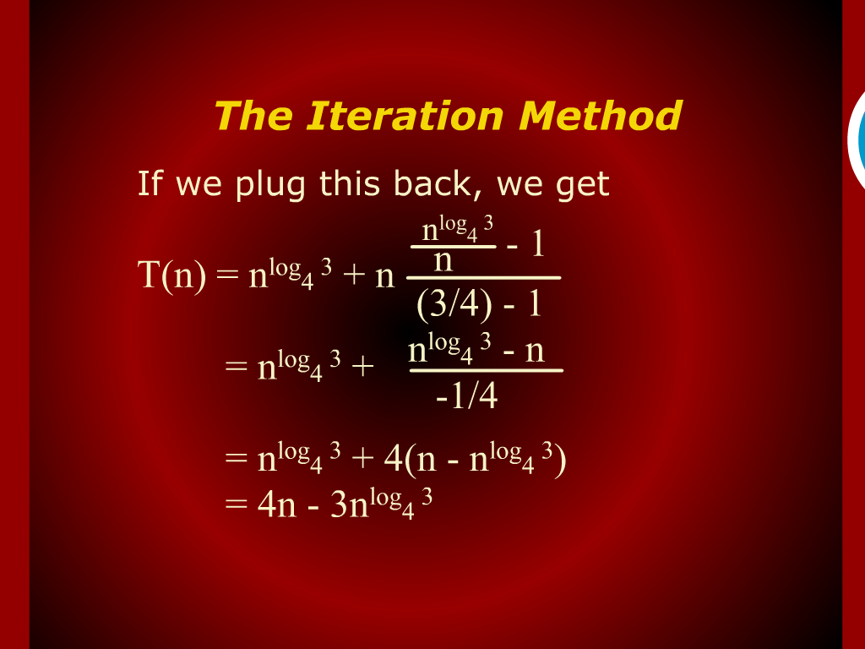
The Iteration Method

Slide 42
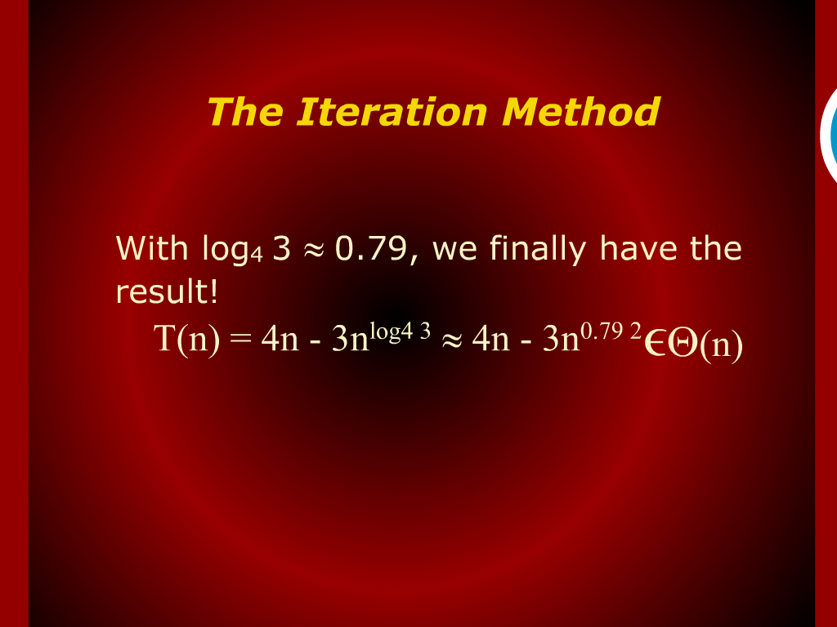
The Iteration Method

